Slide 1
Economy
How to kick start GS preparation?
How to prepare Economy?
Banking: Monetary policy
All PowerPoint Slides available at Mrunal.org/Download

Slide 2



7 Pillars of Economy for UPSC
Pillar #1: Basics of Micro & Macro & Indian Economy
Class11
Types of Economies
LPG reforms
Class12: MACRO
GDP, NNP
National income
Money & banking
Class12- MICRO
Selected only
Mrunal.org/economy

Slide 3
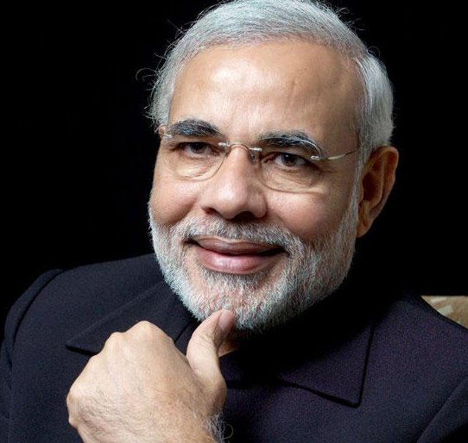
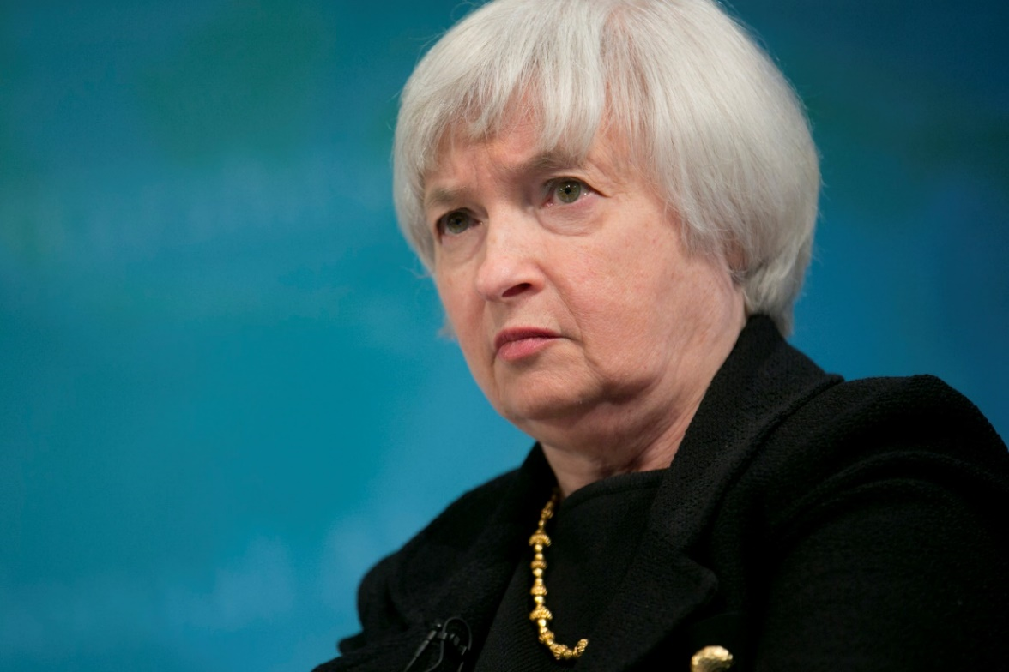

7 Pillars of Economy
2. Banking-Finance
Monetary Policy
Banking Sector
Capital Market
3. Fiscal Policy
Budget, Taxation
Subsidies
Fiscal Deficit
4. International
BoP, CAD
WTO & other Org.
Policies affecting
GS Mains P2

Slide 4
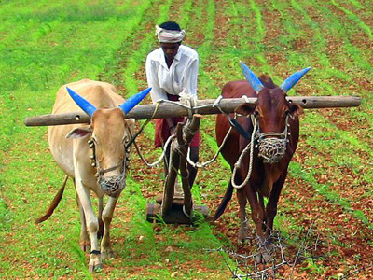

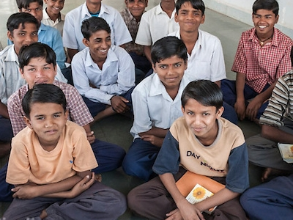
After economic survey is out
5. Sectors of Economy
Agriculture
MSME, Industries
Service sector
6.Infrastructure
Energy
Transport
RUR-URBAN
7. HRD
Skill Development
Poverty line
Weaker sections

Slide 5
Type #1: 7 Pillar focus
CSAT, CAPF, CDS
RBI –Grade “B” Officer Mains
GPSC Mains GS-Economy; similar state service exams

Slide 6
Type #2: firefighting sufficient
Focus area
IBPS: PO/MT, Clerk, Specialist
SBI Clerk/ PO
RBI assistant
Insurance AO, Assistants
SSC (+ theory focus)
Banking-finance (Theory current)
Business-GK, PIN
Budget, Schemes
Then focus on Maths-Reasoning-DI-english

Slide 7
Non-UPSC
UPSC
8th Pillar: Persons in News (PIN), BusinessGK
economy focus on
Facts
Figures
Dates
Names
Numbers
PIN not asked. Hardly 2-3 MCQs in CSAT-2014
Economy Focus on
Principles, Definitions
Cause-consequence
Jurisdiction, features
Pro-Anti

Slide 8

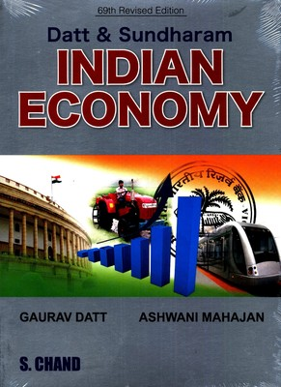
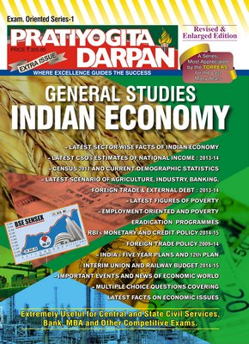
Not Essential for Economy

Slide 9
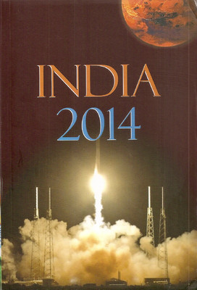
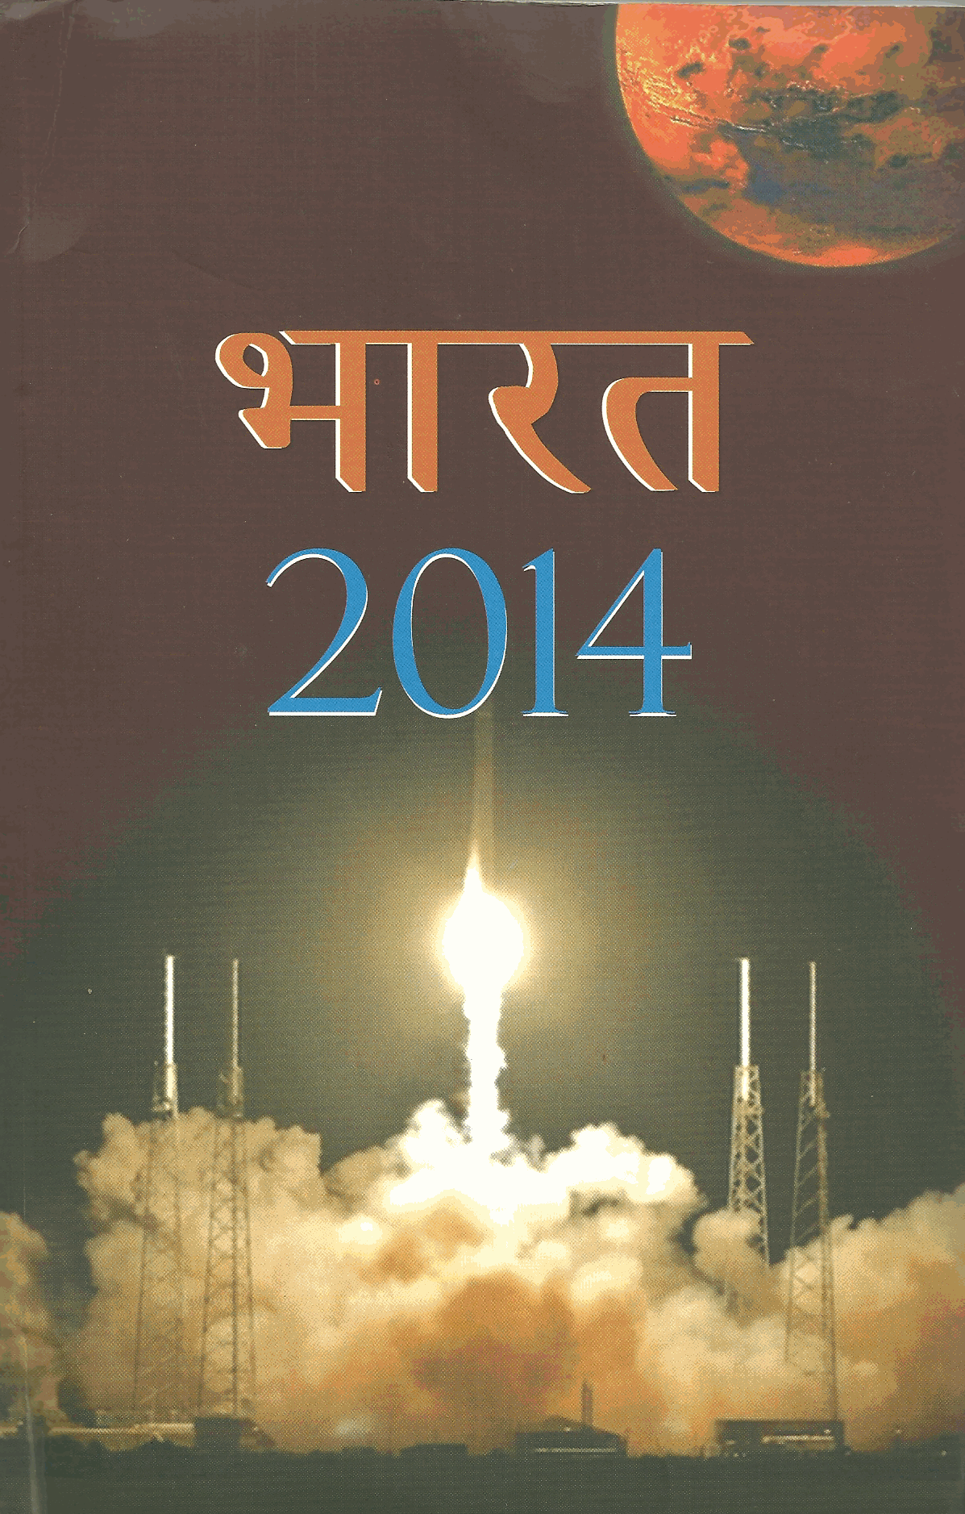
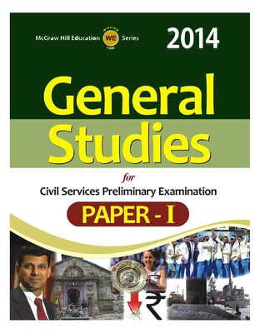

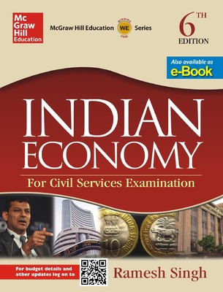
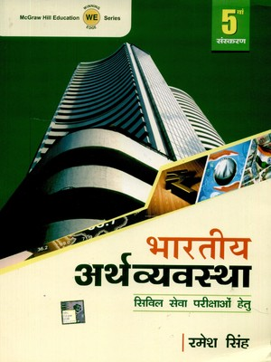


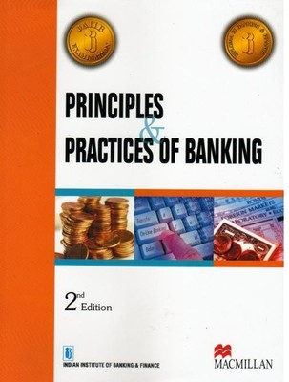
Economy: Dutt Sundaram, Uma Kapila
Budget Speech
Economic Survey
Newspaper

Slide 10
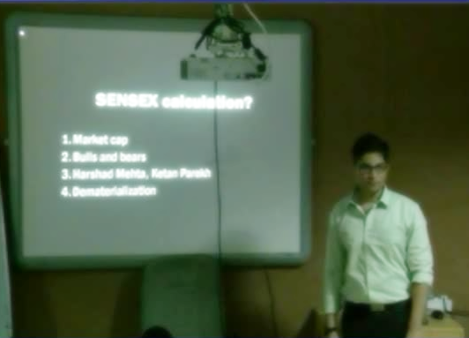
Deadline: by the End of March 2015
NCERT 11, 12
Lecture + Mrunal.org
Budget +Survey
Hindu/IndianExpress
(10 Questions in CSAT-14)

Slide 11
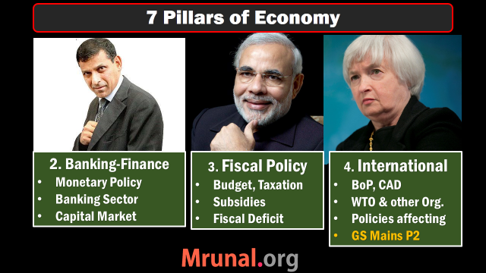
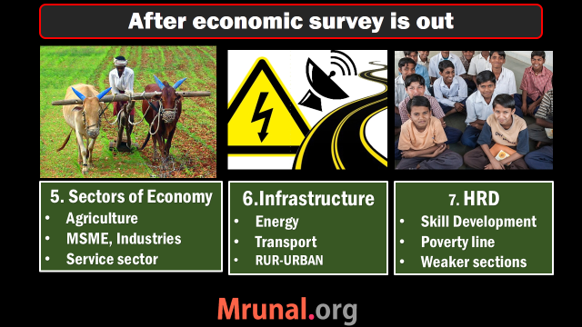
Today’s topic:
Banking ► Monetary Policy
Quantitative | Qualitative tools
CRR, SLR, OMO
Repo, Reverse Repo,
MSF, LAF,
Urjit Patel Committee

Slide 12

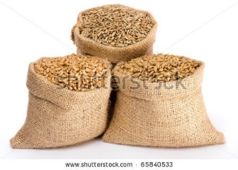

Before money was invented
Double
Coincidence
Of wants
2 kg
500 gms

Slide 13




Birth & Evolution

Slide 14
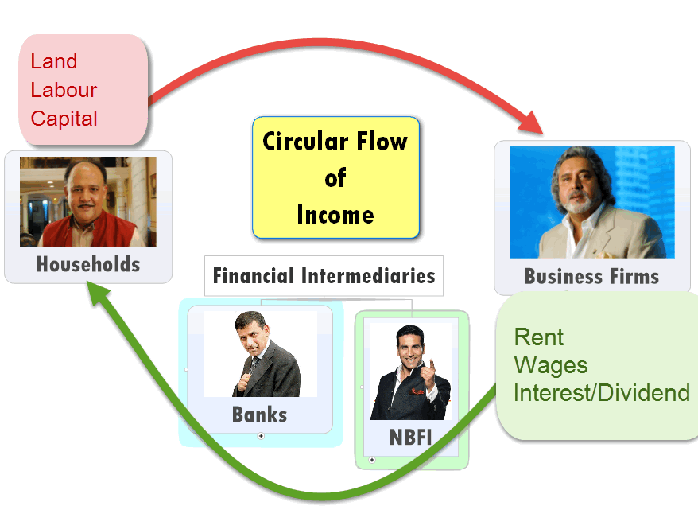

Slide 15
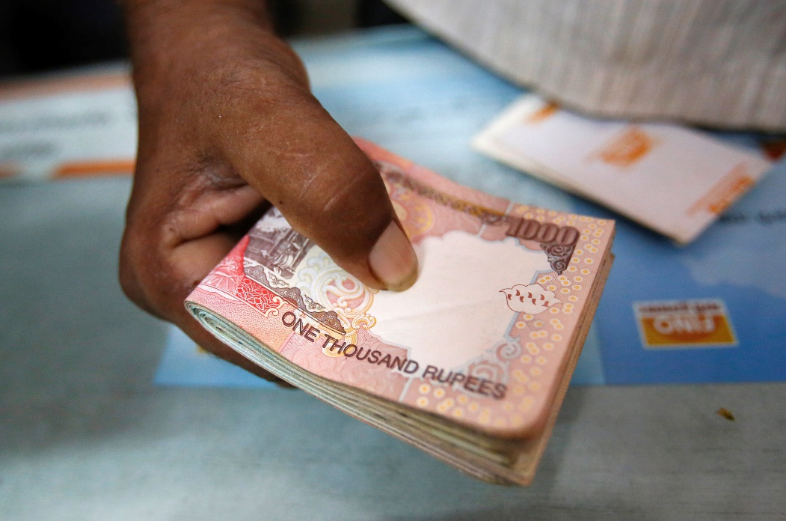
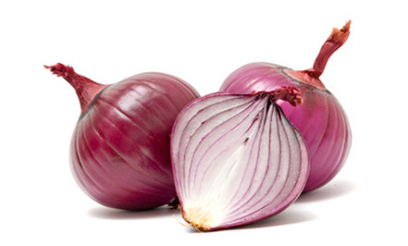
Supply Demand
1 kg = Rs.100
Supply
Demand

Slide 16




Inflation
Demand
Demand
1 kg = Rs.1000
Supply
Demand
Demand

Slide 17
Inflation: increase supply
Demand
Demand
1 kg = Rs.100
Supply
Demand
Demand

Slide 18
Reduce demand by ▼ money supply
Demand
Demand
1 kg = Rs.100
Supply
Demand
Demand

Slide 19
Combat Inflation
Deflation Combat
Reduce Money supply
Tight Money policy
Dear money policy
Increase Money supply
Easy Money policy
Cheap money policy
Notes:
if prices are constantly dropping, consumers will delay spending. Why buy that F-150 today when it will be effectively "cheaper" next week?

Slide 20
Monetary Policy: Instruments?
Quantitative
Qualitative
Reserve Ratios (CRR, SLR)
OMO: Open market operations
Rates (Repo, RR, Bank, MSF, LAF)
Margin / LTV
Consumer Credit control / Down payment
Rationing
Moral Suasion
Direct Action

Slide 21
Reserve Ratios
Cash Reserve Ratio (4%)
Statutory Liquid Ratio (22%)

Slide 22
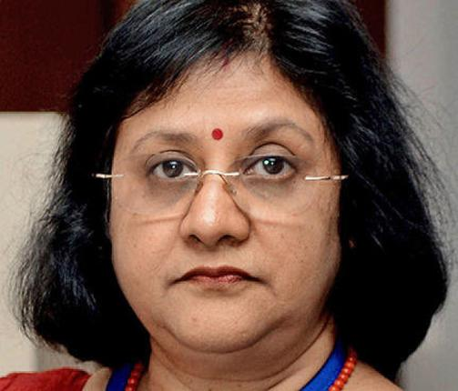

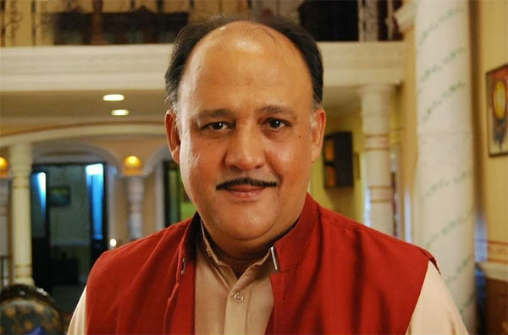
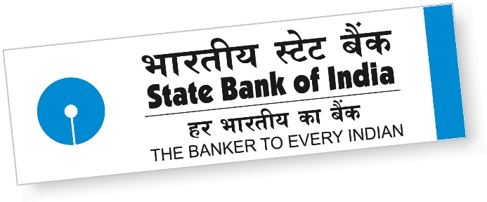
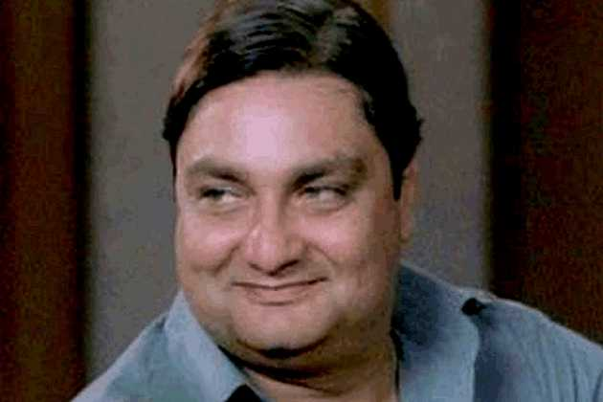
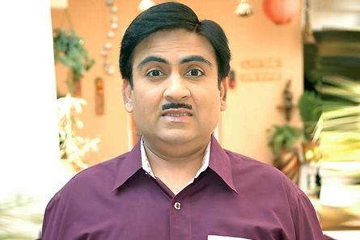
Reserve Ratios
Pay 0-4-9%
Pay 10-15-18%
Depositors
Borrowers
CRR: 04%
SLR: 22%
Total: 26%

Slide 23
Liabilities of a Bank
Demand
Liabilities
Time
Liabilities

Slide 24
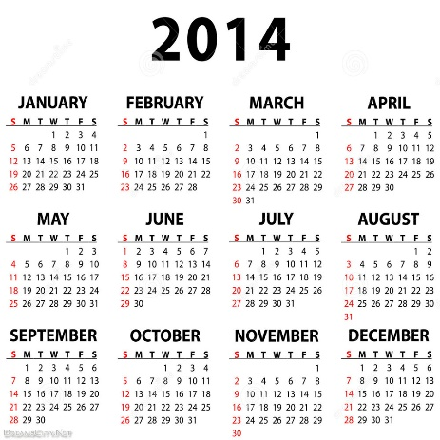
Reserve ratio counted on NDTL
Demand Liabilities
Time liabilities
Current Account (CA)
Savings Account (SA)
Demand Draft
~8,000 Billion Rs.
Fixed deposits (FD)
Recurring deposits (RD)
Cash certificates
Staff security deposits
~78,000 Billon Rs.

Slide 25

1/1/2015
Depositors
Deposited
+120 Cr.
Took out
20 Cr.
Net Demand & Time Liability (NDTL)
120-20=100 Crores.

Slide 26
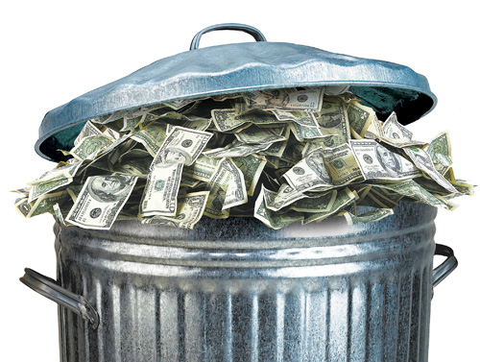
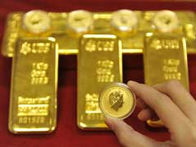

Time: FDRD
NDTL (100 Crore)
Demand: CASA
CRR
4%
SLR
22%
Cash, Gold
RBI approved securities
Can’t lend
No profit

Slide 27
Cash Reserve Ratio (CRR)
Deposit | Examples
Time Deposit | FDRD
Demand Deposit | CASA
NDTL | +100 cr.
Reserve ratio
CRR | (-) 4% [no profit]
All Banks
Penalty
No profit. Except 1999.
Right now 4%
IIM-A Prof D'Souza report: allow gold-forex investment
RBI said No, due to volatility

Slide 28
Statutory Liquidity Ratio
Deposit | Examples
Time Deposit | FDRD
Demand Deposit | CASA
Net Demand and Time Liabilities (NDTL) | +100 cr.
Reserve
CRR | (-) 4 [no profit]
SLR | (-) 22 [some profit]
Money left with bank | =74 cr.
All banks
In Cash, gold, RBI approved securities
Some “profit”.
Right now 22%

Slide 29
Fortnight lag
Fortnight
Fortnight
Friday
NDTL
100 Cr.
Friday
Friday
4 cr. CRR
22 cr. SLR

Slide 30
Reserve Ratios
What is NDTL?
What are SLR and CRR?
How to use them against inflation & deflation

Slide 31
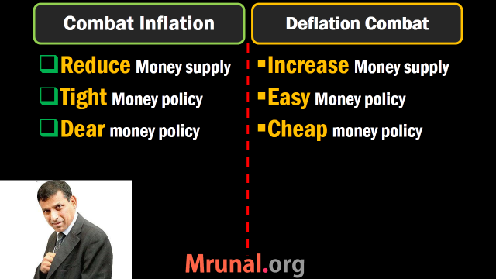

Slide 32
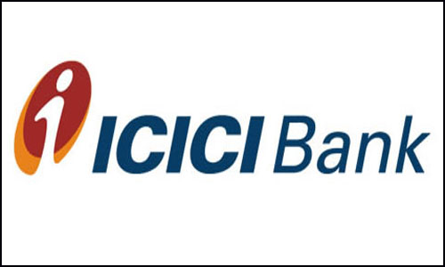
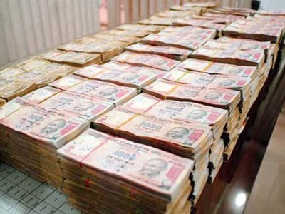
Cyclic fluctuation: Inflation
CRR, SLR: 0%
Loan: 10%
10% of 2 crore
=20 lakh rupees
To combat inflation: REDUCE Money supply

Slide 33
Cyclic fluctuation: Inflation
CRR, SLR: 50%
Loan: 10%
10% of 1 crore
=10 lakh rupees
20% of 1 crore
=20 lakh rupees
To combat inflation: REDUCE Money supply

Slide 34
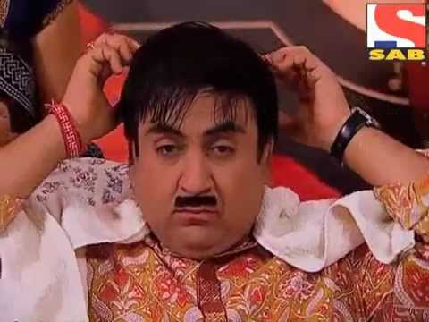

Hike in Bank Loan Interest Rates
10%
20%
50,000/-
48,000/-

Slide 35
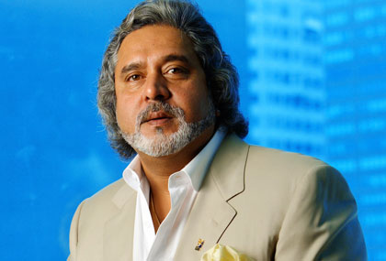
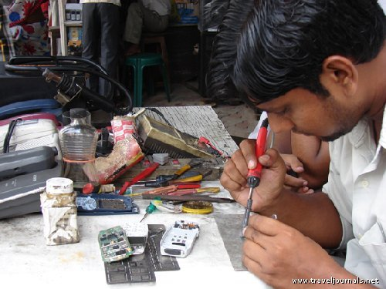



Hike in Bank Loan Interest Rates
10%
20%

Slide 36
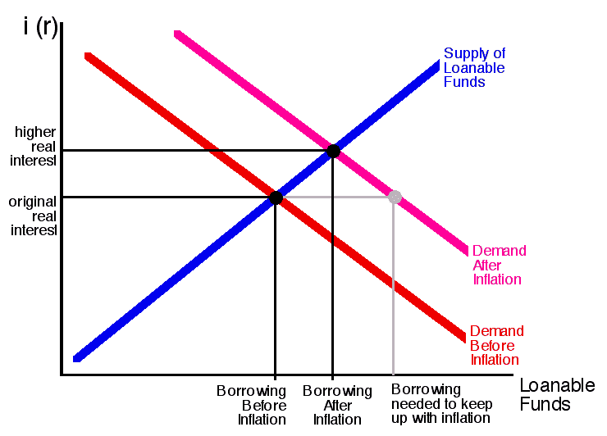

Slide 37
Inflation
Deflation
RBI ▲ CRR/SLR
Banks left with less money to lend
▲ interest rates to keep Profit margin same
People borrow ▼
demand ▼
Prices ▼
= Inflation controlled
RBI ▼ CRR/SLR
Banks are left with more money
They ▼ interest rates to get new clients
People borrow ▲
Demand ▲
= Price ▲

Slide 38
Monetary Policy: Quantitative Tools: Reserve Ratios
 | Inflation fight
HOW? | Tight | Dear
CRR, SLR | ▲▲▲ INCREASE

Slide 39
Monetary Policy: Quantitative Tools: Reserve Ratios
 | Inflation fight | Deflation fight
HOW? | Tight | Dear | Easy | Cheap
CRR, SLR | ▲▲▲ INCREASE | ▼▼▼ DECREASE

Slide 40
Mock Question
Find correct statement(s)?
To combat inflation, RBI should pursue Cheap money policy.
To combat deflation, RBI should increase Statutory liquidity ratio (SLR)
Both A and B
Neither A nor B

Slide 41
Mock Question
Find correct statement(s)?
To combat inflation, RBI should pursue Cheap money policy. (WRONG: follow DEAR/TIGHT)
To combat deflation, RBI should increase Statutory liquidity ratio (SLR) (WRONG: should Decrease SLR)
Both A and B
Neither A nor B (Correct Answer)

Slide 42
Mock Question
Find incorrect statement(s)?
To combat inflation, RBI should pursue Cheap money policy. (WRONG: follow DEAR/TIGHT)
To combat deflation, RBI should increase Statutory liquidity ratio (SLR) (WRONG: should Decrease SLR)
Both A and B (Correct Answer)
Neither A nor B

Slide 43
Mock Question UPSC 2010
When RBI increases CRR, It means ___.
RBI will have less money to lend
Government will have less money to spend.
Commercial banks will have more money to lend
Commercial banks will have less money to lend

Slide 44
Mock Question UPSC 2010
When RBI announces an increase of Cash reserve ratio, what does it mean?
RBI will have less money to lend (irrelevant)
Union government will have less money to spend. (irrelevant)
Commercial banks will have more money to lend (wrong. Reverse will happen)
Commercial banks will have less money to lend (right)

Slide 45
Bi-monthly | 2014 | Bank Rate | MSF | Repo | RR | SLR | CRR
first | April |  |  |  |  | 23 | 4
second | June |  |  |  |  | 22.5 | 4
third | August |  |  |  |  | 22 | 4
fourth | Sep |  |  |  |  | 22 | 4
Fifth | Dec |  |  |  |  | 22 | 4
Surprize | 15/1/15 |  |  |  |  | 22 | 4
Sixth | 3Feb,15

Slide 46
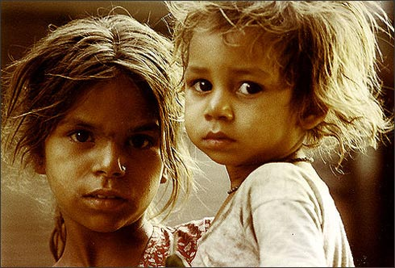
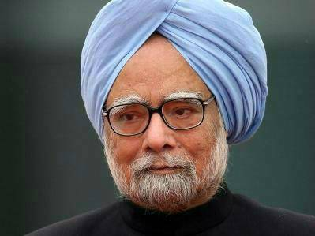
Reserve Ratios
SLR
RBI
Reduced SLR
To flow money in
Productive sectors of Economy
Promised fiscal consolidation

Slide 47

Both counted on NDTL
Have to set aside this much cash in reserve.
Profit? NO!
TIME(FDRD)
Demand (CASA)
Bank Rate 8.75
MSF
8.75
Repo 7.75
RR 6.75
SLR 22%
CRR 4%
Banks have to keep this much in cash, gold, G-sec & other RBI approved securities. Profit? YES

Slide 48
Monetary Policy Quantitative tools
Reserve Ratio (CRR, SLR)
Open Market operation (OMO)

Slide 49

Government securities

Slide 50
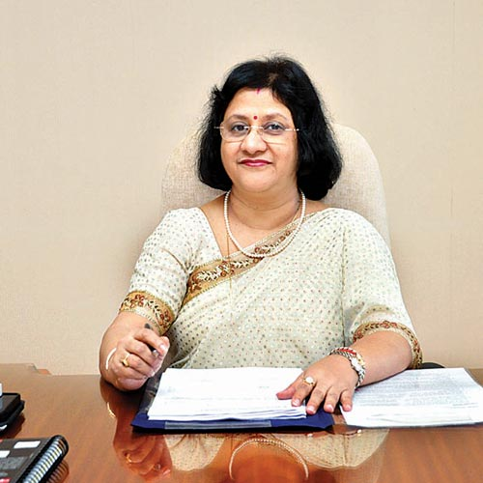

Inflation: Open Market Ops.
To combat inflation, RBI has to reduce money supply

Slide 51
Inflation: Open Market Ops.

Slide 52
Why would banks bother with OMO?
Pay 0-4-9%
Pay 10-15-18%
Depositors
Borrowers
Idle money
=LOSS MAKING
Must invest
G-Sec: 8%

Slide 53
Liquidity / money supply
decreased
Increased

Slide 54
Quant. Tool | Inflation fight Tight/dear
CRR, SLR | Increase
OMO | Sell
To fight inflation,
I’ve to decrease money supply from the system

Slide 55
Quant. Tool | Inflation fight Tight/dear | Deflation fight Easy/ Cheap
CRR, SLR | Increase | Decrease
OMO | Sell | Buy

Slide 56
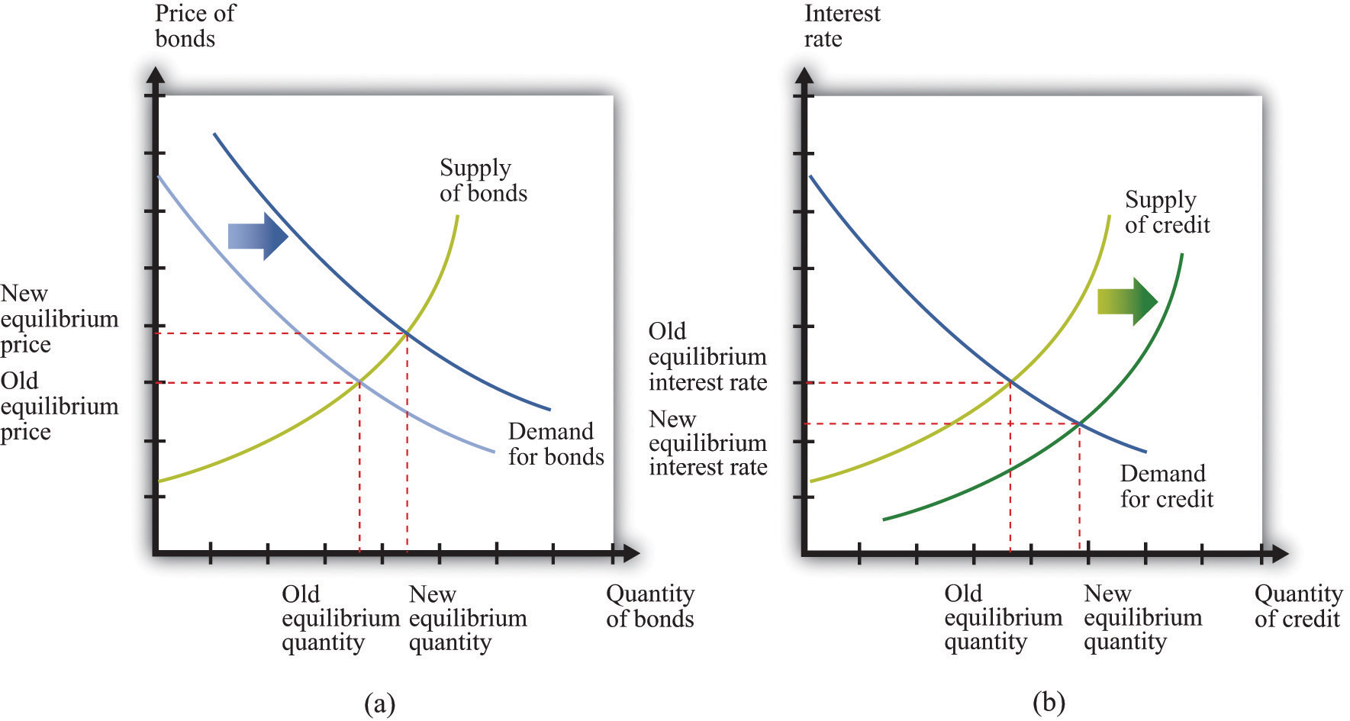

Slide 57
MCQ (UPSC-2013)
In context of Indian Economy, ‘Open Market Operation’ refers to
Borrowing by scheduled banks from RBI
Lending by commercial banks to industries and trade
Purchase and sale of government securities by the RBI
None of Above

Slide 58
MCQ (UPSC-2013)
In context of Indian Economy, ‘Open Market Operation’ refers to
Borrowing by scheduled banks from RBI (Repo/Bank)
Lending by commercial banks to industries and trade (irrelevant)
Purchase and sale of government securities by the RBI (RIGHT)
None of Above

Slide 59
Which of the following will increase Money supply in the economy?
Purchase of government securities from public by central bank
Deposit of currency in commercial banks by the public
Borrowing by government from the central bank.
Sale of government securities to the public by central bank.
CSAT-2012
Answer Choices
Only 1
2 and 4
1 and 3
2, 3 and 4

Slide 60
Which of the following will increase Money supply in the economy?
Purchase of government securities from public by central bank
Deposit of currency in commercial banks by the public
Borrowing by government from the central bank.
Sale of government securities to the public by central bank (Bhai) (DECREASES Money supply)
CSAT-2012
Answer Choices
Only 1
2 and 4
1 and 3
2, 3 and 4

Slide 61
Which of the following will increase Money supply in the economy?
Purchase of government securities from public by central bank (right)
Deposit of currency in commercial banks by the public
Borrowing by government from the central bank. (Public finance)
Sale of government securities to the public by central bank (DECREASES Money supply)
CSAT-2012
Answer Choices
Only 1
2 and 4
1 and 3
2, 3 and 4
Test series “A”, Q77, Ans.C
1. Skip 2. Attempt 3. Mark n Review

Slide 62
Monetary Policy Quantitative tools
Reserve Ratio (SLR, CRR)
Open Market operation
Rates: Bank Rate, Repo Rate, MSF, LAF

Slide 63


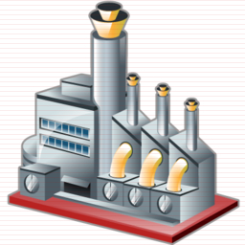
Bank Rate: Meaning?
Long term Loan
Interest rate: 9%
BANK RATE
Collateral: Nothing

Slide 64
Bank Rate 3%
Loans 5%
Bank Rate 36%
Loans 48%
Less demand
Inflation controlled

Slide 65
Monetary Policy
Quant. Tool | Inflation fight | Deflation fight
CRR, SLR | Increase | Decrease
OMO | Sell | Buy
Bank RATE | Increase | Decrease

Slide 66
Bank Rate: WHY?
Not the main tool to control money supply these days.
Bank rate is Linked with penal rates:
If CRR, SLR not maintained:
Penalty= (Bank rate + 3%); 5%

Slide 67
CRR, SLR Fortnight lag
Fortnight
Fortnight
Friday
NDTL
100 Cr.
Friday
Friday
4 cr. CRR
22 cr. SLR
Otherwise penalty
Bank Rate + 3%
Bank Rate + 5%

Slide 68
Have to set aside this much cash in reserve.
No Profit
Long term loan from RBI without collateral
Bank Rate 8.75
MSF
8.75
Repo 7.75
RR 6.75
SLR 22%
CRR 4%
LAF
NDTL
Banks have to keep this much in cash, gold, G-sec & other RBI approved securities. Some profit

Slide 69
LAF: Liquidity Adjustment Facility (2000)
Collateral? = Government security.
LAF | Short term loans.
Repo | When clients borrow from RBI. 8%
Reverse Repo | When clients deposit money in RBI. 8-1=7%

Slide 70
Repo Rate: Meaning?
Repo Rate 8%
100 crore
SBI to Repurchase
@108 Cr.
After 7 days
Collateral: G-Sec
But not from SLR

Slide 71
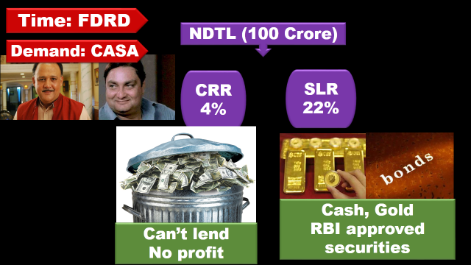

Bank can’t use these G-sec to borrow under Repo

Slide 72
What’s the difference?
LAF (Repo)
MSF
Minimum 5 cr
All clients eligible
Central & State Government
All Banks
NBFI (LIC, UTI)
1 cr.
Only scheduled commercial banks can bid.
Paid up cap. 5l, protect interest of depositors=> RBI Act 1934, 2nd Sch.

Slide 73
LAF (Repo)
MSF
Bank cannot use SLR quota securities
No limit. Borrow according to your securities.
R%
Can use
Maximum limit 0.75% NTDL.
R+1%

Slide 74
Bank use these G-sec to borrow under MSF
0.75% of NDTL
=75 lakh borrow

Slide 75
Reverse Repo Rate: Meaning?
Reverse Repo Rate 7%
100 crore
RBI to Repurchase
@107 Cr.
After 7 days
Collateral: G-Sec
But not from SLR

Slide 76
Reverse Repo
Reverse repo rate = “it is interest rate paid by RBI to its clients for short term loans.”
Central & State Government, All Banks, NBFI
Collateral: government securities
2011: RR = Repo – 1% (100 basis points).
Dec 2014: Repo = 8%.
Reverse repo =8-1=7%

Slide 77
Reverse Repo -1%
Repo (7.75%)
MSF +1%
POLICY RATE
1%= 100 basis points
8%- decreased by 25 basis points
8.00-0.25=7.75 (15/Jan/15)

Slide 78
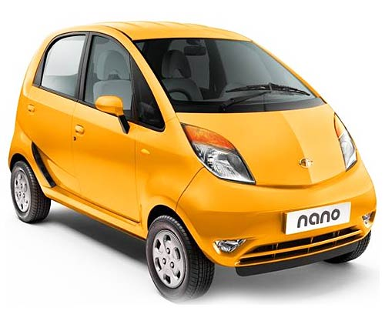
During inflation
Repo Rate 8%
Car Loan 13%
1,00,000

Slide 79
During inflation: Tight money policy
Repo Rate 8%
Car Loan 13%
Repo Rate 18%
Car Loan 36%
70,000

Slide 80
Monetary Policy
Quant. Tool | Inflation fight
CRR, SLR | Increase
OMO | Sell
Policy Rate | Increase

Slide 81
Monetary Policy
Quant. Tool | Inflation fight | Deflation fight
CRR, SLR | Increase | Decrease
OMO | Sell | Buy
Policy Rate | Increase | Decrease

Slide 82
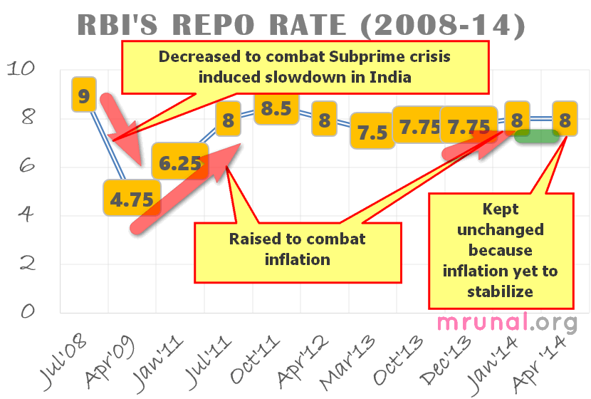

Slide 83
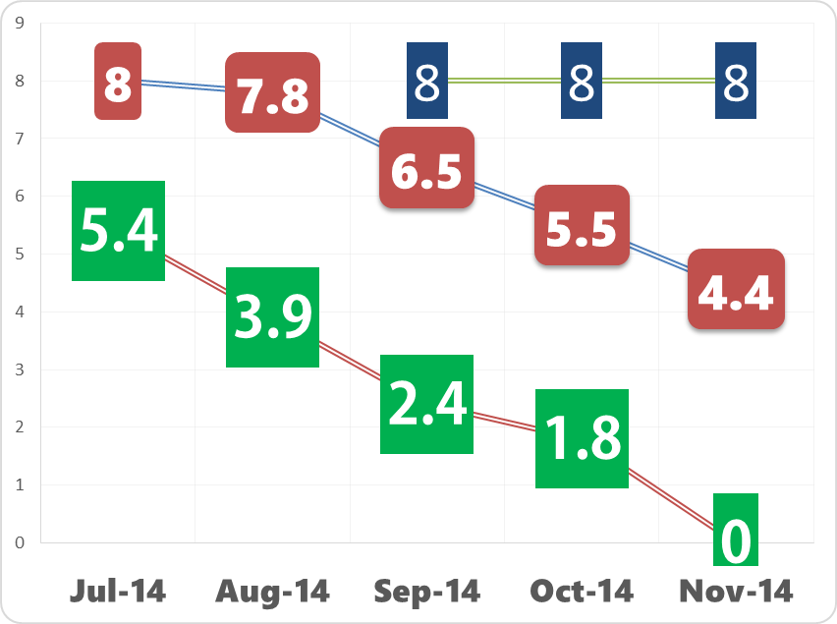
Repo Rate
CPI
WPI

Slide 84
Bi-monthly | 2014 | Bank Rate | MSF | Repo | RR | SLR | CRR
first | April | 9 |  | 8 |  | 23 | 4
second | June | 9 |  | 8 |  | 22.5 | 4
third | August | 9 |  | 8 |  | 22 | 4
fourth | Sept,30 | 9 |  | 8 |  | 22 | 4
Fifth | Dec, 2 | 9 |  | 8 |  | 22 | 4
Surprise | 15/1/15 | 8.75 |  | 7.75 |  | 22 | 4
Sixth | 3-Feb-15

Slide 85
Bi-monthly | 2014 | Bank Rate | MSF +1 | Repo | RR -1 | SLR | CRR
first | April | 9 | 9 | 8 | 7 | 23 | 4
second | June | 9 | 9 | 8 | 7 | 22.5 | 4
third | August | 9 | 9 | 8 | 7 | 22 | 4
fourth | Sept,30 | 9 | 9 | 8 | 7 | 22 | 4
Fifth | Dec, 2 | 9 | 9 | 8 | 7 | 22 | 4
Surprize | 15/1/15 | 8.75 | 8.75 | 7.75 | 6.75 | 22 | 4
Sixth | 3-Feb-15

Slide 86
All clients can borrow short term loans from RBI @this interest rate. can’t use SLR securities though!
Have to set aside this much cash in reserve
=no income
Long term loan from RBI
Bank Rate 8.75
MSF
8.75
Repo 7.75
RR 6.75
SLR 22%
CRR 4%
Only for Sch. Commercial banks can borrow from RBI @this Interest rate. Can even use SLR securities
What RBI pays to its clients for short term loans
Banks have to keep this much in cash, gold, G-sec & other RBI approved securities

Slide 87
CSAT-2014
The terms 'Marginal Standing Facility Rate' and 'Net Demand and Time Liabilities', are used in relation to
Banking operations
communication networking
military strategies
supply and demand of agricultural products

Slide 88
Limitation of Monetary policy
Why it failed to contain inflation? (2013-14)
Urjit Patel Committee recommendations

Slide 89
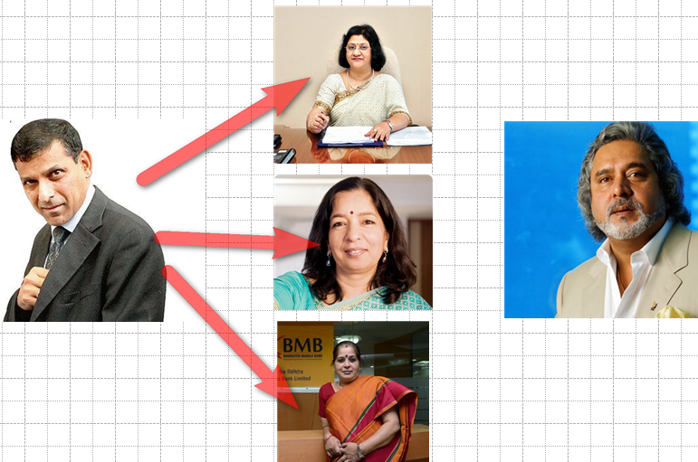
How does Policy rate affects economy?
Notes:
Arundhati bhattacharya, Shikha Sharma MD & CEO. Usha anathasubramium

Slide 90
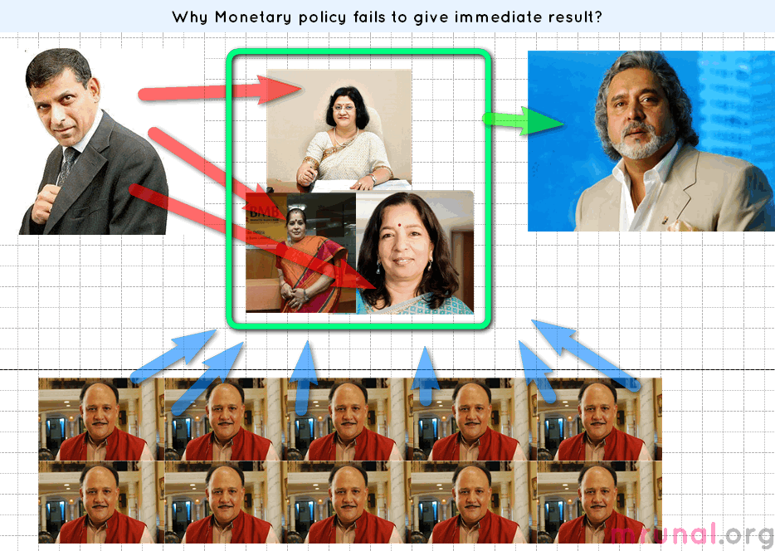
Billion Rs. | 2013
DEMAND | 8,142
TIME | 77,963

Slide 91
Monetary Policy: limitations (Developing-countries)
People don’t have many investment alternatives. So, Commercial banks have high deposits.
Unorganized money market; Shroff; lack of financial inclusion
Monsoon uncertainty, cyclone, flood, draughts => Supply side constrains

Slide 92
Monetary Policy: limitations (Developing-countries)
Crude oil, gold import
Fiscal deficit, subsidy leakage, Black money, underground economy
Solution: Urjit Patel Committee

Slide 93
Committees by RBI
Bimal Jalan
New Bank Licenses
Feb 2014 report given
Nachiket Mor
Financial products for small businessmen and low income household.
Urjit Patel
Revise and Strengthen Monetary policy framework
Financial inclusion: banking, credit, investment, insurance. + consumer protection
RBI board of directors.
Dy. Governor
Retired governor

Slide 94
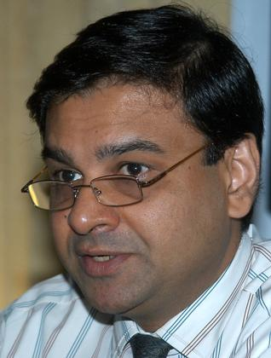
Monetary Policy Reforms
Urjit Patel
Expert Committee to Revise and Strengthen the Monetary Policy Framework
January 2014 report:
Three Major Recommendation:
RBI inflation targets (2-6%)
Government help RBI
RBI fix accountability

Slide 95
Until Now
Urjit Patel
WPI
But 60% GDP comes from service sector.
Multi-targets: reduce inflation, GDP growth, employment growth….
CPI (All India Urban + Rural)
Minimum inflation: 2%
Maximum 6%
=4% (+/- 2% band)
Similar system in Mexico, S.Africa, Israel

Slide 96
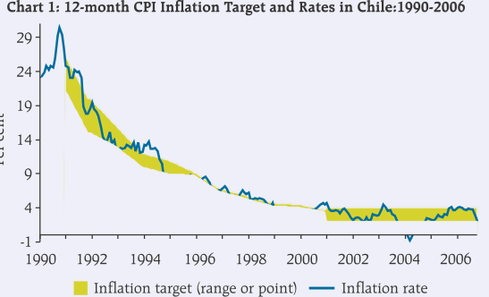
Nominal Anchor 4% CPI: When? Timeframe
Chile:
90s CPI 25%
2000s: CPI target 3% (+/- 1% band)

Slide 97
Nominal Anchor 4% CPI: How? RBI?
Reverse Repo -1%
Repo (R%)
MSF +1%
Policy rate= LAF repo Rate
Decided by voting in MPC.
Reverse repo=-1% (100 basis point)
MSF=+1%
Spread +1/-1 should not be changed frequently
Keep Repo higher than CPI

Slide 98
Monetary policy under Rajan
Bi-monthly Policy | 2014 | MSF | Repo | RR Repo | CPI target
first | April | 9 | 8 | 7 | started
second | June | 9 | 8 | 7
third | August | 9 | 8 | 7
fourth | Sept,30 | 9 | 8 | 7

Slide 99
Monetary policy under Rajan
January | CPI Target
2015 | 8%
2016 | 6%
Challenges:
60% El Nino
Geopolitical problems
Subsidies

Slide 100
Repo Rate
CPI
WPI

Slide 101
Monetary Policy
Urjit Patel
RBI target inflation with deadline
Government should help RBI
RBI’s accountability has to be fixed

Slide 102
Government to help RBI
Urjit Patel
MNREGA: wage increased…yes. Productive growth…no?
Subsidy leakage, corruption…X
Administered price…x
Fiscal consolidation

Slide 103
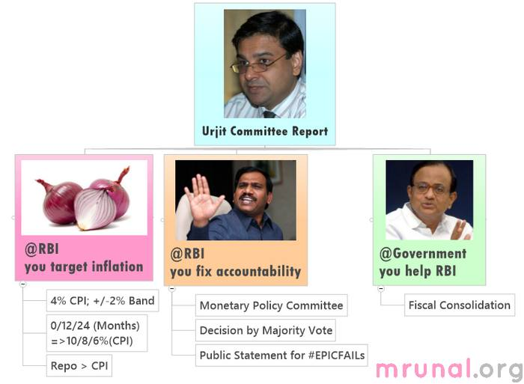

Slide 104
Monetary Policy: accountability in India
RBI Act.
Governor directly accountable to Government
Govt. can issue directives to RBI in public interest.
Parliament’s standing Committee on finance- can summon Governor Avg. 3-4/year.
Monetary policy made by Governor alone. (sign.)
OVERALL No formal accountability mechanism.

Slide 105
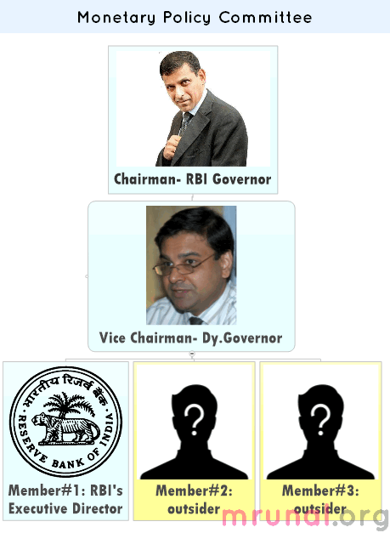

Slide 106
Urjit: Monetary Policy: accountability in India
Target: 4% (2% band)= 2-6% .
Failure?? Three quarters successively.
MPC issue public statement
Each member will sign it
Reasons for failure
Action proposed
Time-frame for result.

Slide 107
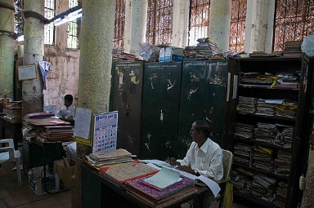

Each cluster headed by COO
Dy.Gov. rank
Need Govt. approval
Monetary policy
Regulatory
Supervision
Financial market
Services
Existing dept will be grouped into FIVE clusters

Slide 108
Monetary Policy
NCERT Class12: Macroeconomics
Chapter 3 Money and banking
Ignore complicated graphs-formula-equations
Mrunal.org/economy
Economic Survey=> WPI, CPI, IIP, inflation
Mrunal.org/Banking
Banking=>Urjit Patel article
Update PPT with Monetary policy

Slide 109
Next time
Qualitative tools
Banking sector evolution since British India
Financial inclusion: PM-JDY, KVP etc.

